Slide 1

THE ESSER FEDERAL GRANTS
FPCS Stakeholder Advisory Board Meeting
May 18, 2022

Slide 2
WELCOME
Thank you for agreeing to serve on the FPCS ESSER III Stakeholder Advisory Committee!
This group will meet twice yearly for three years
Members will provide the district with feedback and guidance about how grant funds are used
Members will receive regular updates about implementation and results

Slide 3
A Brief History of ESSER
The ESSER fund was first authorized under the Coronavirus Aid, Relief, and Economic Security (CARES) Act in March 2020
The ESSER II fund was authorized under the Coronavirus Response and Relief Supplemental Appropriations (CRRSA) Act in December 2020
The ESSER III fund was authorized under the American Rescue Plan (ARP) Act in February 2021

Slide 4
FPCS
COVID SPENDING

Slide 5
CARES ACT ESSER I 4290 $714,768
Purchase Chromebooks
Dell laptops
Computer desktops
Additional custodial support for cleaning buildings
COVID nurses
Promethean boards, laptops cases, software (elevation)
PPE Equipment
Cleaning materials and solutions
Signage for schools
Sanitation machines, masks, face shields

Slide 6
CARES ACT ESSER I 4290 $714,768
Classroom Cameras – not purchased for every classroom- that money will be used to pay LETRS Stipends for staff who complete LETRS training
Promethean Boards and additional chemical purchases will be pushed to ESSER II funds

Slide 7
ESSER II FUNDS 1,009,397.05
Purchase high quality language arts and mathematics materials (iREADY software, Shurley curriculum, mathematics software, math manipulative individual student kits, teacher stipends for retooling pacing guides
Purchase high quality language arts and mathematics professional development iREADY pathway training and toolboxs, Orton Gillingham training and stipends, National math conference, and AMSTI Numbers stipends
Assessment data, computer lab upgrades FPMS/FPHS
After School tutoring, summer school camps

Slide 8
ESSER II Funds (continue)
Educational software- Edgenuity, ACT materials/software
Social worker salary, mental health training, wellness curriculum, Securly software
Blackboard and additional educational software recommended by tech department, server replacements, iPads, Desktops, Promethean boards
Additional bus Wi-fi
Switch Cars, virtual Drivers ed lab
HVAC units, window replacements, additional custodians, floor cleaning machines

Slide 9
ALLOCATIONS
Total State Allocation- $2,020,070,466
FPCS- ARP-ESSER $6,477,351.00
FPCS ARP-ESSER-SR $689,149.00

Slide 10
The Purpose of ARP ESSER Funds
Help
Help safely reopen schools to in-person instruction
Sustain
Sustain the safe operation of schools
Address
Address the impact of the coronavirus pandemic

Slide 11
Stipulation about the Use of ESSER III Funds
Each LEA must reserve at least 20% of its total allocation from the state to address learning loss
►Learning loss must be addressed using evidence-based interventions
►Interventions must respond to students’ social, emotional, and academic needs
►Interventions must address the disproportionate impact of COVID-19 on underrepresented student subgroups (each major ethnic group, children from low-income families, children with disabilities, English learners, gender, migrant students, students experiencing homelessness, and children and youth in foster care)

Slide 12
Other Allowable Uses of ESSER III Funds
LEAs may use ESSER III funds for a wide range of activities including (but not limited to):
✔Development of protocols to maintain the health and safety of students, educators, and other employees
✔Repair and improvement of school facilities to reduce the risk of virus transmission and exposure to environmental health hazards
✔Providing meals to eligible students
✔Providing technology for online learning
✔Planning and providing summer learning and after-school programs
✔Providing continuity of services so that existing staff can continue to work and new staff can be hired as needed

Slide 13

ESSER III Survey
Stakeholders began to respond to the survey in July 2021. The survey was available until the start of the 2021-2022 school year.
More that 200 responses were recorded.

Slide 14
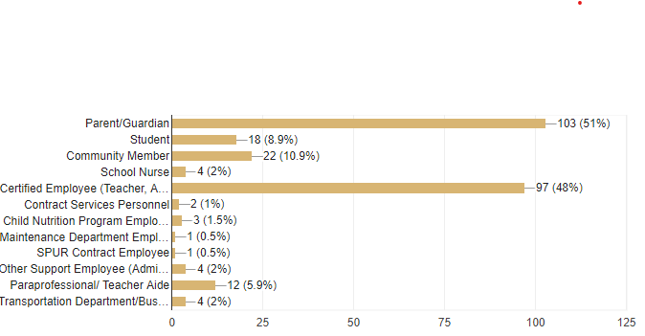
Stakeholders Who Responded to the Survey

Slide 15
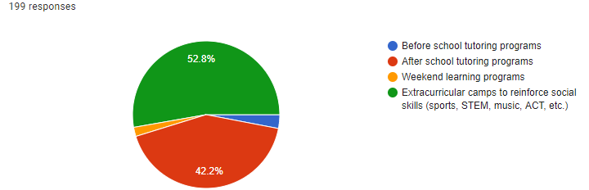
What type of program should the school system consider to improve student learning beyond the traditional school day?

Slide 16
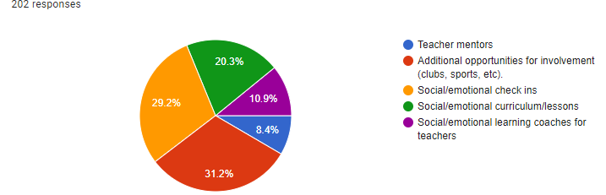
What support do you believe would be most helpful in addressing negative impacts of COVID -19 on the social, emotional, and mental health needs of students?

Slide 17
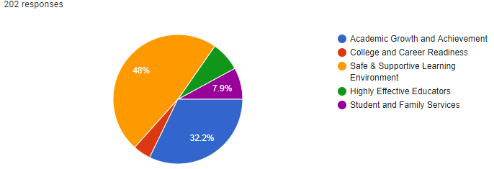
In your opinion, what is THE highest priority needs (academic, social/emotional, and/or mental health, etc.) for the 2021-2022 academic year?

Slide 18
FPCS ARP ESSER SPENDING
Plan From Fall 2021
ARP-ESSER $6,477,351.00
STAFF
WVES: .5 Virtual Teacher, 7 Instructional Aides
LRIS: .5 Virtual Teacher, 1 Math Intervention Teacher, 1 reading Interventionist-one year, 1 Janitor
WAES: 1 Janitor
FPMS: 1 Agriscience Teacher, 1 Fine Arts Teacher, 1 Interventionist
FPHS: 1 Interventionist- Graduation Coach

Slide 19
FPCS ARP ESSER SPENDING (Continue)
A percentage of Summer Literacy Camps- 3 years
A percentage of After School Tutoring program for WVES/LRIS – 3 years
Contract with Behavioral Specialist to address student behaviors- 3 years
Bus Tracking Software
Computers and Monitors
Educational Materials and Supplies
Cleaning materials and Supplies
Indirect Cost

Slide 20
FPCS ARP ESSER SPENDING (Continue)
Replace Air Condition Units at WVES, FPMS, FPHS, Central Office, Transportation Department, WAES, Greenhouse, Maintenance Building, and Baseball facility
Replace Roofs at WVES, Central Office, WVES lunchroom and replace HVAC on that roof
Renovate restrooms and Windows at WAES
Replace water fountains with water bottle fillers
WAES furnish Drama room
BEAT Center equipment and supplies
FPMS Agri-Science equipment

Slide 21
FPCS ARP ESSER-SR SPENDING
State Reserve Funds Usage- must address learning loss through the implementation of evidence-based interventions and ensure that those interventions respond to students’ social, emotional, and academic needs and address the disproportionate impact of COVID-19 on underrepresented student subgroups (each major racial and ethnic group, children from low-income families, children with disabilities, English learners, gender, migrant students, students experiencing homelessness, and children and youth in foster care).
FPCS received: $689,149.00
LRIS: Reading Interventionist 2 years
FPHS: 1 EL Teacher, 1 SPED Teacher 3 years
A percentage of Summer Literacy Camp
A percentage of After School Tutoring

Slide 22
Proposed Amendments (December 2021)
The seven Instructional Aides at WVES will be replaced with the following:
WVES- 1 STEM Teacher and 1 Intervention Teacher
LRIS- 1 Intervention Teacher
The overall cost to the system for the 3 Teaching positions will be comparable to the cost of the 7 Aide positions

Slide 23
Salaries for ESSER III FY 2022
STAFF 2021-2022
STAFF 2021-2022
WVES:
.5 Virtual Teacher for WVES (Jett)
1.0 STEM Teacher (Henderson)
1.0 Interventionist (Gilbert)
LRIS:
1.0 Math Interventionist (Coots)
1.0 Janitor
1.0 Interventionist (Yancey)
1.0 Interventionist (Unfilled)
WAES:
1.0 Janitor- Unfilled
FPMS:
1 Agriscience Teacher (Unfilled)
1 Drama/Fine Arts Teacher (Smith)
1 Interventionist(Saint)
FPHS:
1 Graduation Coach/Interventionist (unfilled)
1 SPED Teacher (Henshaw)
1 EL Teacher (Unfilled)
System Wide: Contract- Huntsville Behavior Associates $90,000

Slide 24
Student Tutoring/ Camps
Provided after school tutoring for both WVES and LRIS for four afternoons each week. Total Cost estimate ESSER III
$ 234,000 for FY 23-FY24
Total paid this year $170,000- out of ESSER II
Summer Literacy Camp estimated cost $130,000 to be paid with $70,000 state funds and additional out of ESSER III.

Slide 25
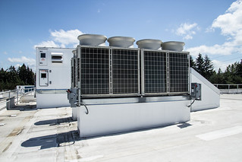
New Air Condition Units Budgeted: $1,809,500
WVES- $975,000
FPMS-$100,000 (only 5th grade)
FPHS- $335,000, Greenhouse 5,500, Baseball facility 42,000
Central Office- $12,000
Transportation- $50,000
WAES Renovation- $265,000
Maintenance Shop- $25,000
TOTAL-$1,809,500 Word in Progress $122,430 spent

Slide 26
Roofing and Renovations Budgeted
$1,030,460
Roof at WAES -275,000- Not to be completed at this time, added to renovation cost
Renovations at WAES 200,000 + 275,000
Roof at CO - 200,000
Roof and HVAC WVES LR-185,000
Water fountains with bottle fillers – 50,000

Slide 27

Equipment $683,339
Drama Room WAES $139,041
BEAT Center Equipment (green cars) $300,000
Seon Bus Tracking $13,478 Purchased
Ag Science Equip FPMS $100,000
Dell computers and monitors $62,100 Purchased
Apple MacBooks Robotics $68,720 - $9,300- In Progress

Slide 28
Instructional Materials and Supplies
$28,779.46
Job Coach Curriculum $5,200 FPHS
ACT Materials $3,600 FPHS
School Specialty $2,125.35
Publishers Warehouse-curriculum $1,346.91
Teachtown- Autism curriculum $2,557.29
IXL Learning-$2,776
EMS-$4,842,91
Learning A-Z-$5,982
STEM materials $349.00

Slide 29
Additional Supplies and Services
BCBA- Behavioral Specialist $3,033 monthly
Supplies for nurses and cleaning- $26,253.60
Bus tracking system $13,478
Renovation for WAES Ongoing project due to overcrowding at WVES and FPHS- painting, fencing, electrical work, flooring, acoustics, etc.

Slide 30
Total ESSER III SPENDING
Total Salaries (May 1, 2022) $226,176.24
1
Total Completed Purchase Orders $413, 866.13
2
Total Encumbered Purchase Orders $ 205,437.75
3
Total Spending: $845,480.12
4

Slide 31

Discussion
Questions
Comments/ Concerns
Recommendations

Slide 32
THANK YOU FOR YOUR TIME AND PARTICIPATION!

